Slide 1
DATABASE MANAGEMENT SYSTEM PROJECT
TOPIC – UNIVERSITY MANAGEMENT SYSTEM
SUBMITTED BY:-
ANAMIKA SINGH(19104008)
BHUWAN SHARMA(19104018)
DINESH(19104028)
JAINAM SOGANI(19104038)
NIMIT JAIN(19104058)
POTTA LOKESH(19104068)
RAVI(19104078)
SUBMITTED TO:-
DR. RAJNEESH RANI
ASST. PROF . DEPT. OF CSE
SARTHAK GUPTA(19104088)
SHIV KUMAR(19104098)
TEJAVTH NAVEEN(19104108)
YASH VIJAYVARGIYA(19104118)
SHREENAV KHANDELWAL(19106089 REPLACED 19104048)

Slide 2
INTRODUCTION
We developed this project on the basis of our learning in DBMS, SQL, File handling and programming language(C++).
The upcoming slides contain the ENTITY- RELATIONAL MODEL (ER MODEL) and the RELATIONAL MODEL of the project.

Slide 3
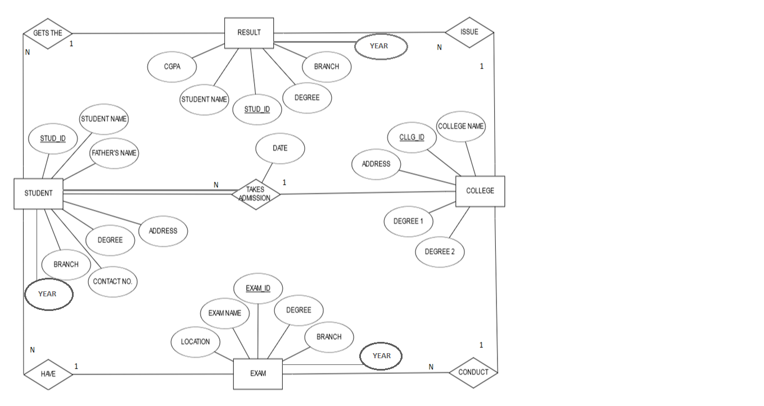
ENTITY-RELATIONAL MODEL

Slide 4
STUDENT
RELATIONAL MODEL
STUDENT NAME | STUD_ID | FATHER’S NAME | ADDRESS | CONTACT_NO. | DEGREE | BRANCH | YEAR | CLG_ID | EXAM_ID | ADMISSION_DATE
RESULT
STUDENT NAME | STUD_ID | DEGREE | BRANCH | YEAR | CGPA | CLG_ID
COLLEGE
COLLEGE NAME | CLG_ID | ADDRESS | DEGREE 1 | DEGREE 2
EXAM
EXAM NAME | EXAM_ID | DEGREE | BRANCH | YEAR | CLG_ID | LOCATION

